Slide 1
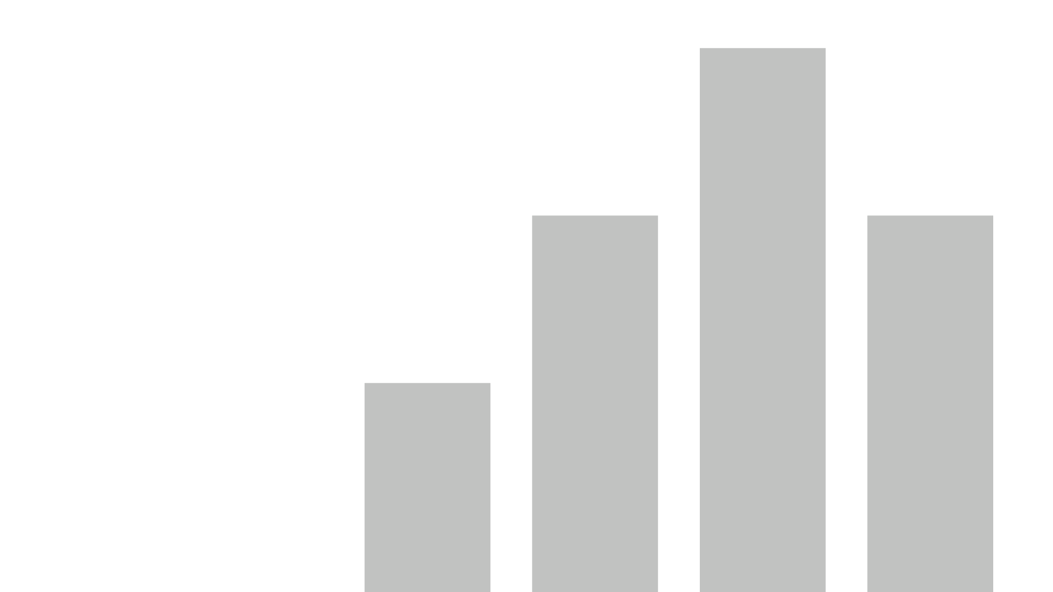
Report FEB24
Last data refresh:
3/4/2024 11:53:38 AM UTC
Downloaded at:
12/26/2024 5:01:49 AM UTC

Slide 2
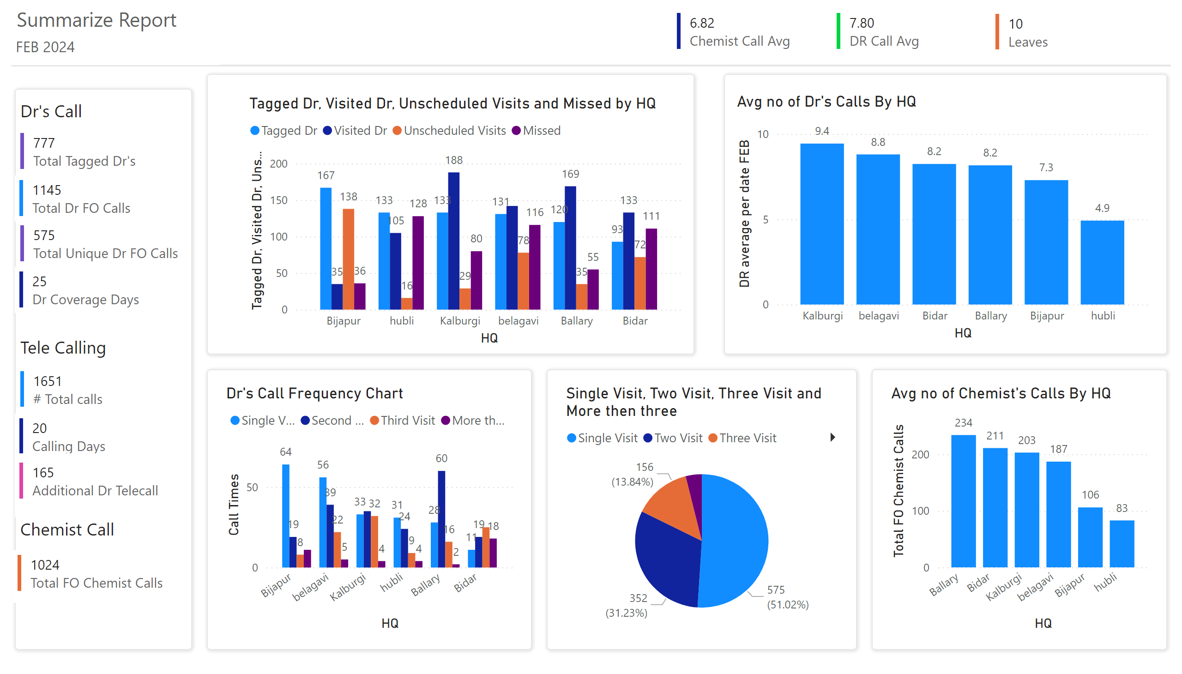
Summarize Report-1
Notes:
multiRowCard
No alt text provided
multiRowCard
No alt text provided
Avg no of Dr's Calls By HQ
No alt text provided
shape
No alt text provided
textbox
No alt text provided
textbox
No alt text provided
multiRowCard
No alt text provided
multiRowCard
No alt text provided
shape
No alt text provided
shape
No alt text provided
Frequency Graph
No alt text provided
shape
No alt text provided
multiRowCard
No alt text provided
multiRowCard
No alt text provided
Frequency Graph
No alt text provided
multiRowCard
No alt text provided
multiRowCard
No alt text provided
textbox
No alt text provided
textbox
No alt text provided
Avg no of Chemist's Calls By HQ
No alt text provided
Dr's Call Frequency Chart
No alt text provided
textbox
No alt text provided
multiRowCard
No alt text provided
multiRowCard
No alt text provided
multiRowCard
No alt text provided
clusteredColumnChart
No alt text provided
Frequency Graph
No alt text provided
pieChart
No alt text provided

Slide 3
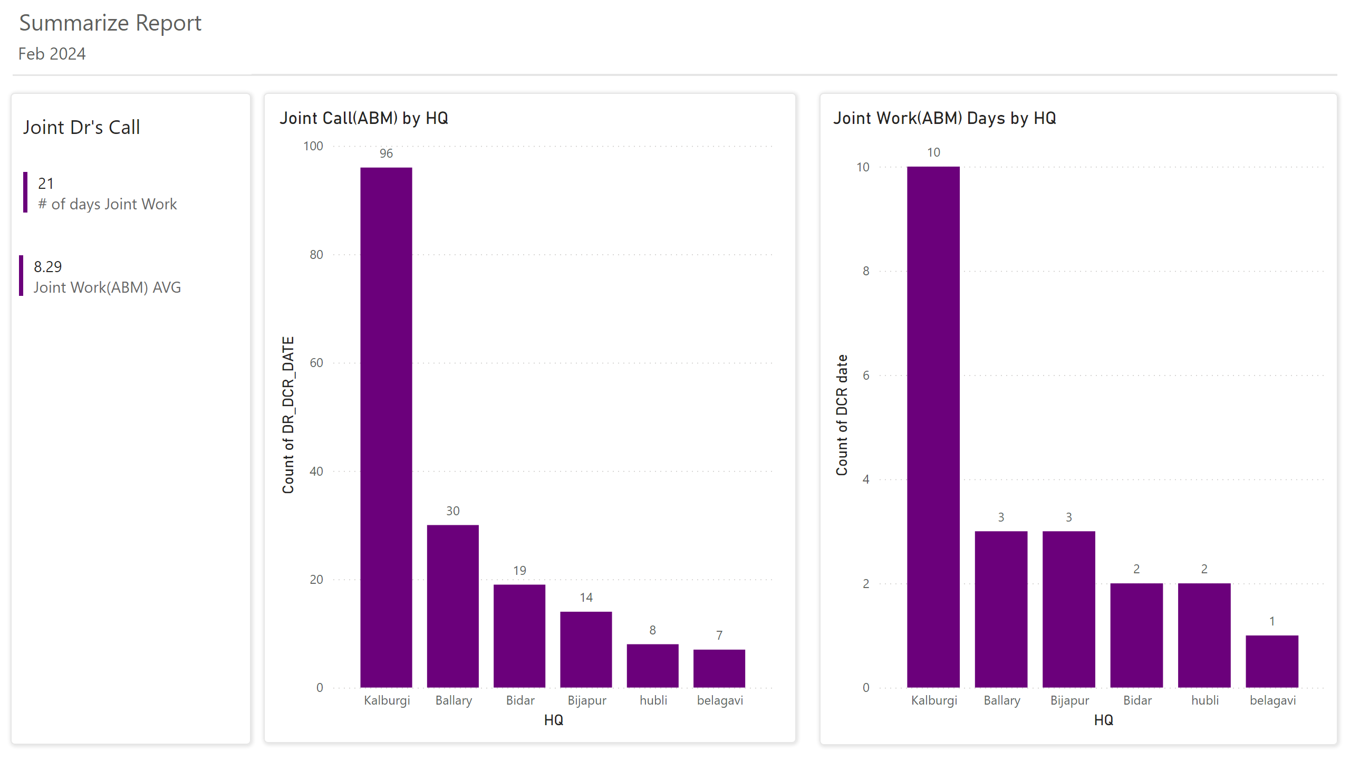
Summarize Report-2
Notes:
multiRowCard
No alt text provided
multiRowCard
No alt text provided
Joint Call(ABM) by HQ
No alt text provided
Joint Work(ABM) Days by HQ
No alt text provided
textbox
No alt text provided
shape
No alt text provided
Frequency Graph
No alt text provided
shape
No alt text provided
shape
No alt text provided
textbox
No alt text provided
textbox
No alt text provided

